Slide 1
Project Report: Customer Retention Project By:Himanshu Soni| Fliprobo Internship11| Batch 1824 – Datatrained |

Slide 2
ACKNOWLEDGMENT
I would like to thank my mentors at Data Trained, who taught me the concepts of Data Analysis, building a machine learning model, and tuning the parameters for best outcomes.
For this particular task, I referred the following websites and articles when stuck:
• • https://towardsdatascience.com/a-common-mistake-to-avoid-when-encoding-ordinal-features-79e402796ab4
• • https://stackoverflow.com/questions/43590489/gridsearchcv-random-forest-regressor-tuning-best-params
• • https://www.codegrepper.com/code-examples/delphi/scikit+pca+preserve+column+names+pca+pipeline
• • https://stackoverflow.com/questions/22984335/recovering-features-names-of-explained-variance-ratio-in-pca-with-sklearn
This assignment was assigned by our mentor at FlipRobo, Swati Rustagi

Slide 3
Problem Statement: -
Analysis of Retail factors for customer activation and retention : A case study from Indian e-commerce customers

Slide 4
INTRODUCTION
The Indian e-retail market is rising exponentially, as is competitiveness among marketers. The performance of the online retail store depends on the amount of customers it draws and the same becomes a determining factor for the strategic edge.
Excluding robust and sustained visitor traffic from multiple sources, it would be almost difficult for a digital retail store to be successful. However, it is necessary to ascertain that the traffic is of good quality, consisting of users who are involved in the online transaction

Slide 5
IMPORTING IMPORTANT LIBRARIES
## import the data basice labrary
import pandas as pd
import numpy as np
import seaborn as sns
import matplotlib.pyplot as plt
%matplotlib inline

Slide 6
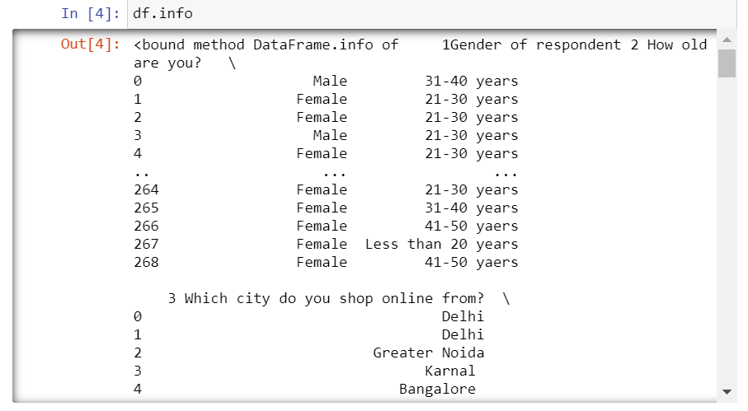
DATA ANALYSIS The graph below shows the datatypes . It can be observed that there are a large number of columns which are mostly categorical, interval scale or rating scale.
The graph below shows the datatypes . It can be observed that there are a large number of columns which are mostly categorical, interval scale or rating scale.

Slide 7
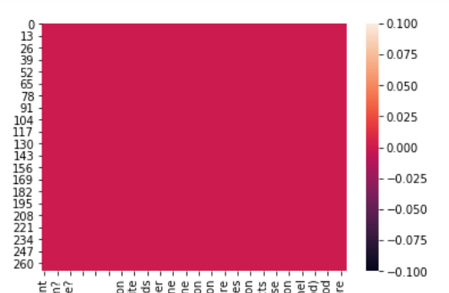
NULL VALUES
A heatmap shows that there are no null values in the dataset

Slide 8
I have started by analyzing and plotting the most common features which are considered by the consumers in order to make purchase decisions or decisions related to the choice of e-commerce platform.
This is based on the literature review and study of articles as part of my secondary research
I have summarized the results at the end

Slide 9
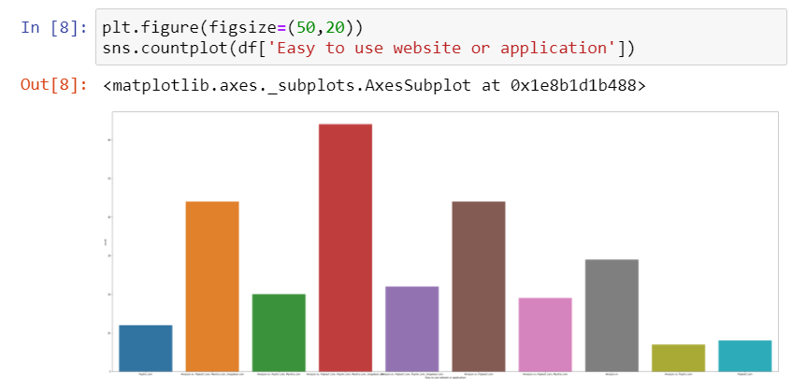
EASE OF USE OF WEBSITE AND INTERFACE

Slide 10
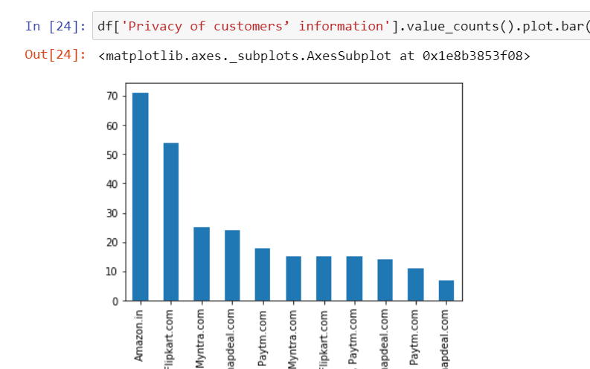
PRIVACY OF INFROMATION

Slide 11
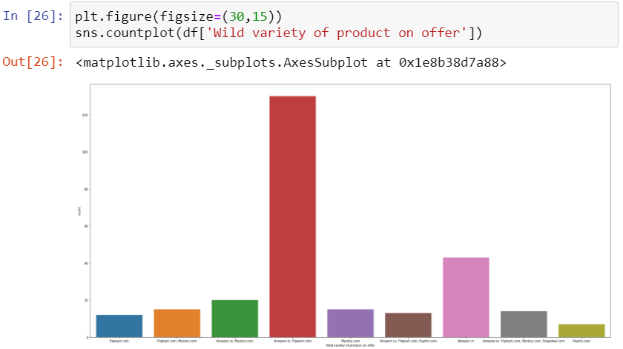
VERIETY OF PRODUCTS OFFERED

Slide 12
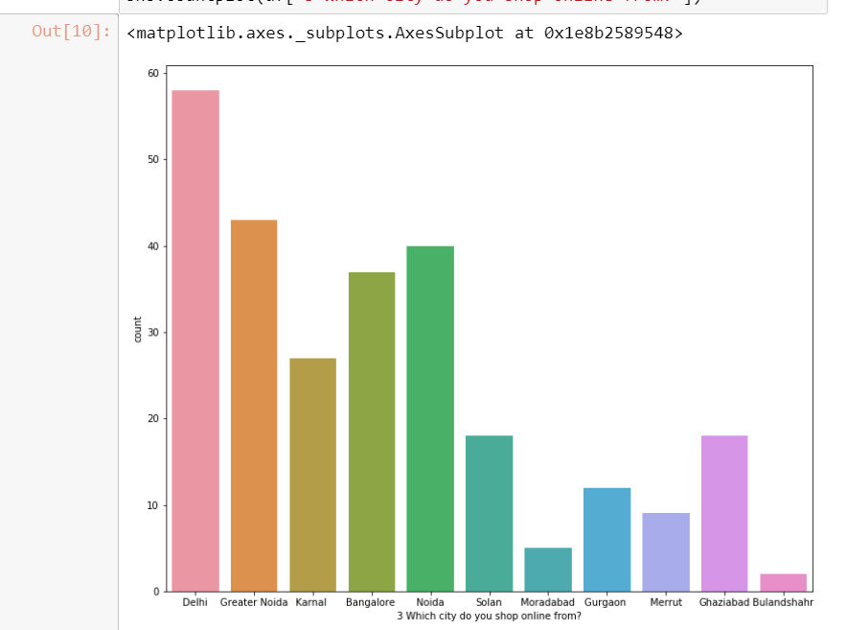
ANALYSIS SHOWING THE DISTRIBUTION AND GEOGRAPHICAL CONCENTRATION OF THE CONSUMERS

Slide 13
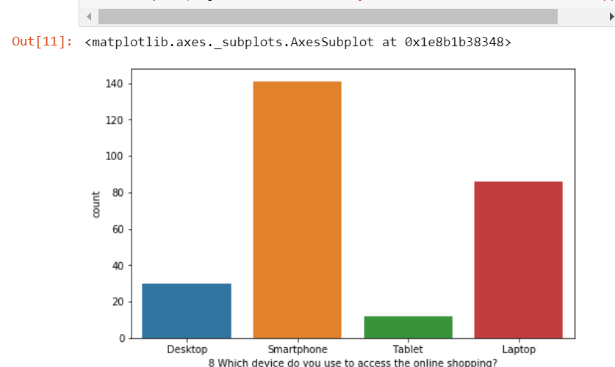
CHOICE OF DEVICE USED FOR ONLINE PURCHASE AND THE SOURCE OF INTERNET

Slide 14
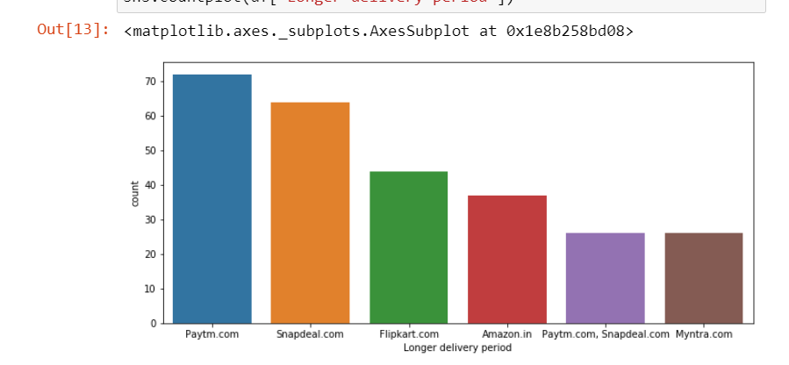
DELIVERY PERIOD- CHOICE OF THE ECOMMERCE WEBSITE

Slide 15
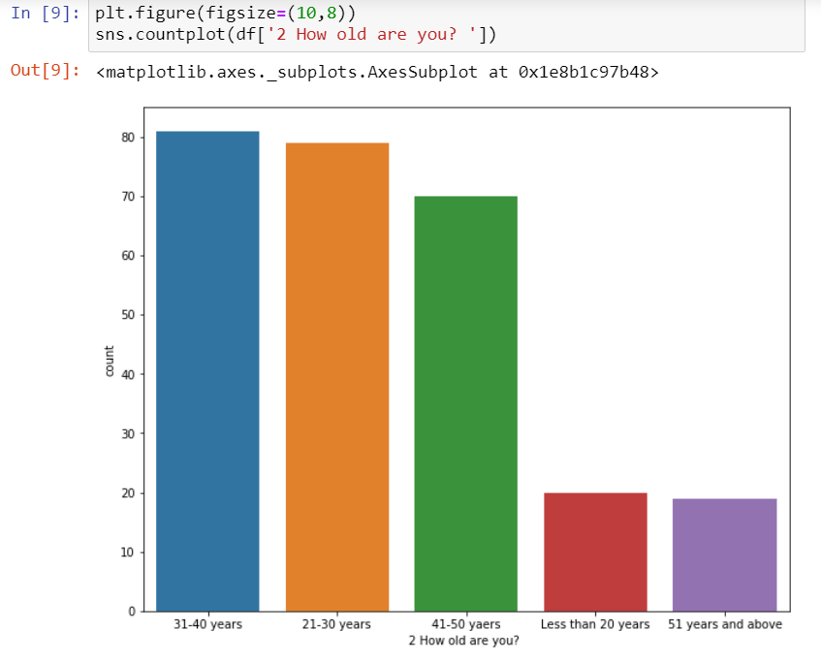
AVERAGE AGE OF RESPONDANTS WHO WERE USING THESE PLATFORMS

Slide 16
SOME OF THE OBSERVATIONS FROM THE DATA ANALYSIS ARE-
Amazon and flipkart offer maximum veriety of products
Majority of the respondents are concentrated in Delhi
Smartphone is the most commonly used device for online shopping
Most people use mobile internet for shopping

Slide 17
Continued..
Based on perceived trustworthiness Amazon is the website that people would recommend
Most people think that shopping online is more convenient that shopping offline
Most customers have been shopping for more than years in thi study
Search engine marketing is the most common type of marketing channel used

Slide 18
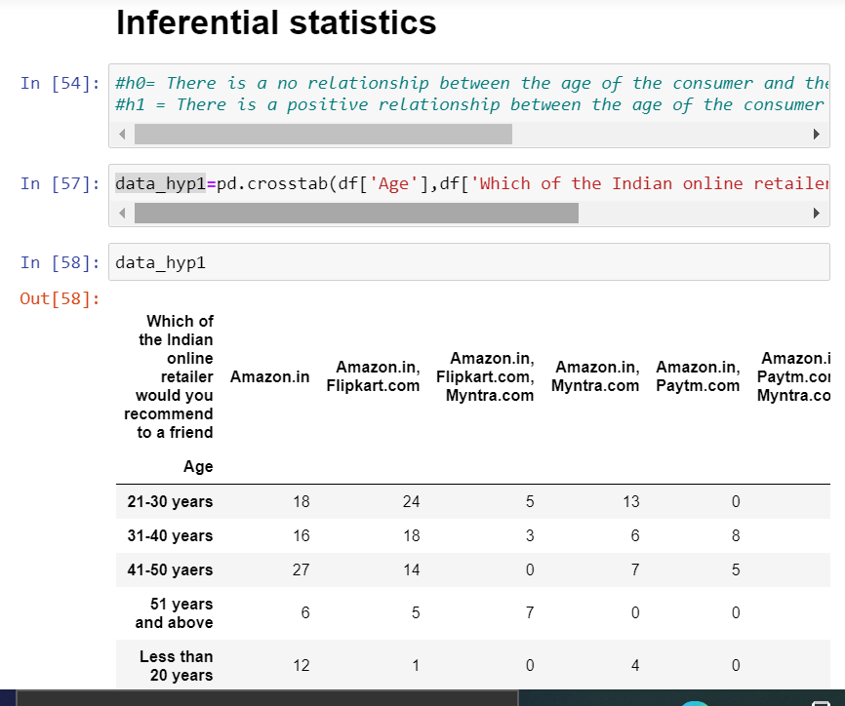

Slide 19
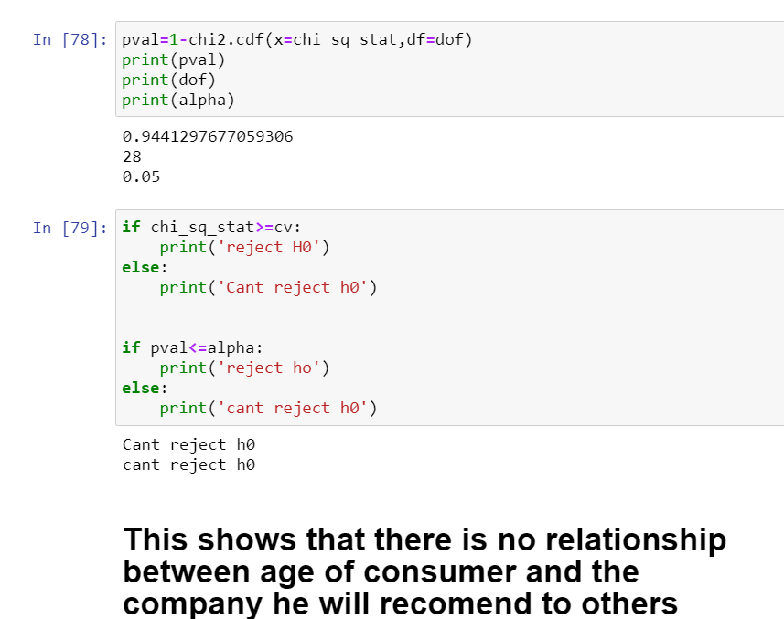

Slide 20
Here I have experimented with just one hypothesis that I formed and used chi-square test as a method of inferential statistics
Ultimately the result suggested not to reject the null hypothesis showing no major relationship between the age of consumer and the company he recommend

